Slide 1
Named Entity Resolution (NER) for Customer Segmentation
A production FSI case study in ML application observability
Vikram Maran

Slide 2
The problem
Company
Context
Problem statement
One of the largest compliance-focused banks in the country, Wells Fargo
Site Reliability/Architecture Team is assessing options to centralize/observe/triage NER applications for fraud detection and customer segmentation (ex: location matching)
NER model performance degradation issues difficult to root cause across model, data, infra

Slide 3
Problem:
When NER accuracy drops 3%, you can't quickly answer: Is it the model? The data? Infrastructure?

Slide 4
Brownfield: What Wells Fargo Has Today
Component | Current State | Problem
Infrastructure Monitoring | Datadog (mature) | Shows latency/availability, but not model-specific signals
Model Monitoring | Custom Python dashboards | Reactive, not predictive; lag in detection
Data Quality | Basic checks | Incomplete; doesn't catch distribution drift
Incident Response | ServiceNow rules | Slow triage; can't determine root cause quickly
The Gap: When NER accuracy drops 3%, you can't quickly answer: Is it the model? The data? Infrastructure?

Slide 5
Role/Persona Suggestions
SRE/Architecture Team [Josh, Dan, George, John, Maoyu, Tzhou]
Security/Network Architects
Application Architect [Dan]
Data Architect [George]
ML/AI Architect [John]
Site Reliability [Maoyu, Tzhou]

Slide 6
Discovery Questions
How much engineering capacity do you have available?
What's your timeline? When do you need this working?
Do you have GDPR/data residency requirements?
Open source vs. commercial? What's your preference?
How long does incident triage currently take?
How mature is your data quality monitoring?
What's your risk tolerance around adopting new tooling?

Slide 7
Solution Options: Buy vs Build
Dimension | Path 1: Custom | Path 2: Hybrid | Path 3: Cloud
Timeline | 16-20 weeks | 6-8 weeks | 4-6 weeks
Engineering Effort | 2-3 FTE × 4mo | 1 FTE × 6-8w | Minimal (SaaS)
GDPR Compliant | ✓ Yes | ✓ Yes | ✗ No
Total Cost (5yr) | $$$$ | $$$ | $$
Best For | Maximum control | Speed + control | Speed only

Slide 8
Build Option
Design:
Python service pulling model + infra + data metrics
Correlation logic (the hard part)
Grafana dashboard + alert routing
Pros | Cons
Maximum control (no vendor lock-in) Fully GDPR compliant Customize rules exactly as you want | Building causal inference is non-trivial Ongoing maintenance burden (1.5-2 FTE long-term) Risk of gaps (what you didn't think to monitor)

Slide 9
Hybrid Option
Architecture:
Custom Ingestion Layer (on-prem) → InsightFinder Cloud (analysis) → Root Cause
Pros | Cons
Faster time to value (6-8 weeks) Causal Inference for free GDPR compliant Less Ops burden (0.5 FTE vs 1.5-2) | Two systems to keep in sync, with each capable of causing different failure modes. Data may have to be anonymized & de-anonymized. Software updates will have to be timed synchronously.
You keep raw customer data on-prem. Custom layer anonymizes and sends only signals to InsightFinder.

Slide 10
Buy/SAAS Option
Architecture:
NER System → InsightFinder SDK → InsightFinder Cloud (managed)
Pros | Cons
Fastest time to value (4-6 weeks) Lowest engineering effort (minimal integration) Lowest ongoing ops burden (SaaS) Full platform (everything included) | Data residency / GDPR issue (customer data goes to cloud) Less control over raw data Probably not viable for this use case (compliance constraints)

Slide 11
Client Recommendation: Hybrid
Rationale:
GDPR compliance is non-negotiable (data stays on-prem)
6-8 week timeline fits business urgency
1 FTE engineering capacity is realistic
Causal inference is InsightFinder's moat (don't reinvent)
Lower long-term ops burden
Timeline: 6-8 weeks to full observability Cost: Engineering + InsightFinder SaaS Risk: Low (you control data, InsightFinder controls analysis)

Slide 12
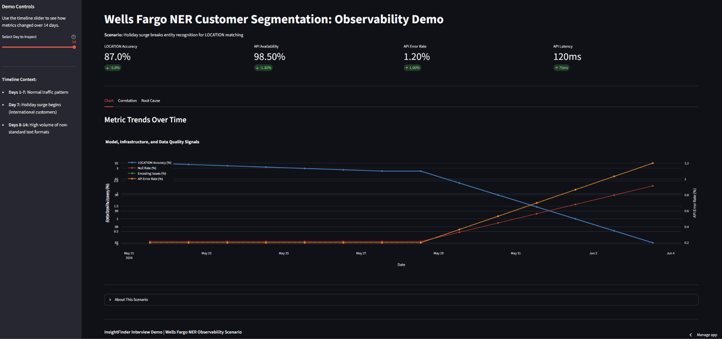
Demo
What You Actually Use:

Slide 13
Solutioning Beyond Wells Fargo 2024
InsightFinder Components:
Component | Used? | Why
Core (Causal Inference) | ✓ Critical | Figures out root cause
Infrastructure Correlation | ✓ Critical | Unique capability
Data Observability | ✓ Optional | Enhances custom checks
Model Monitoring | ✓ Partial | Accuracy tracking
ARI (Auto Remediation) | ✗ No | Too risky for compliance

Slide 14
Thank You!
Vikram Maran

